Slide 1


Welcome to the Woods!

Slide 2
Your Connections…
Student Support
Admin
Office Staff
EA’s
The Resource Centre
Counsellors / Youth worker
School Liaison
Career Centre
Families
EAL
Classroom Teachers

Slide 3
Counselling
THE HERITAGE WOODS TEAM:
Principal
Vice-Principals
Todd Clerkson
Jill Reid (A – G)
Manjit Rai (H - N)
Mark Rao (O - Z)
Youth Worker
Shaunna Martin (A - G)
Paul Gangnes (H - N)
Curt De Wolff (O - Z)
Karin Leathwood
Career Facilitator
Darilyn Butler
Learning Centre
English Alternate Learner
Pat Vance
(Team Leader)
Angeline Lee
  (Team Leader)

Slide 4
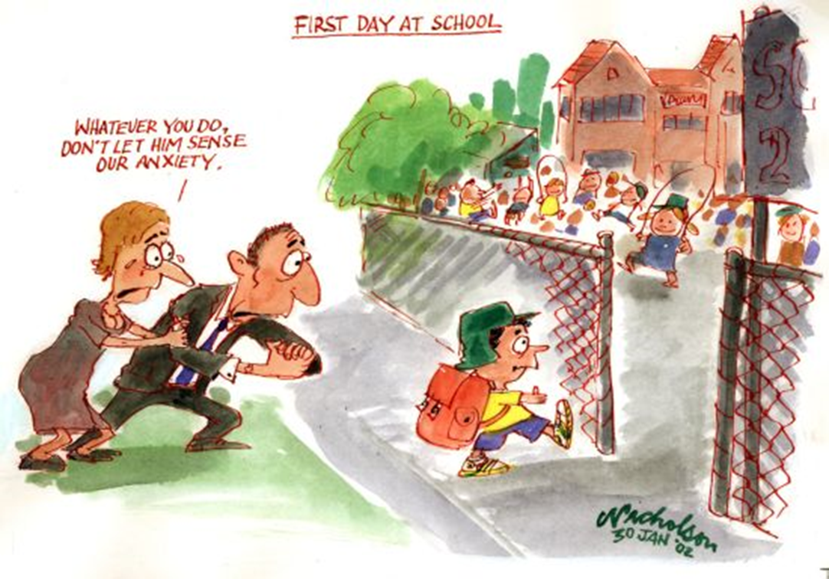

Slide 5

How Things Work:
Two semesters each school year
  Semester 1: Sept-Jan
  Semester 2: Feb-June
Students take 8 courses over 2 semesters
Classes are 72 minutes long
Flex Blocks: Tue-Fri, 30 mins of tutorial time with a teacher
Some students take additional courses outside of the bell schedule (band, choir, agility)

Slide 6

Bell Schedule…
MONDAY | TUESDAY | WEDNESDAY | THURSDAY | FRIDAY
Block 1 8:00-9:12​ | Block 1 8:00-9:12 | Block 1 8:00-9:12 | Block 1 8:00-9:12 | Block 1 8:00-9:12
Block 2 9:16-10:28 | Block 2 9:16-10:28 | Block 2 9:16-10:28 | Block 2 9:16-10:28 | Block 2 9:16-10:28
FLEX 10:28-10:57 | FLEX 10:28-10:57 | FLEX 10:28-10:57 | FLEX 10:28-10:57 | FLEX 10:28-10:57
Block 3 11:01-12:13 | Block 3 11:01-12:13 | Block 3 11:01-12:13 | Block 3 11:01-12:13 | Block 3 11:01-12:13
LUNCH 12:13-12:53 | LUNCH 12:13-12:53 | LUNCH 12:13-12:53 | LUNCH 12:13-12:53 | LUNCH 12:13-12:53
Block 4 12:57-2:09 | Block 4 12:57-2:09 | Block 4 12:57-2:09 | Block 4 12:57-2:09 | Block 4 12:57-2:09
Block 5 2:13-3:25 | Block 5 2:13-3:25 | Block 5 2:13-3:25 | Block 5 2:13-3:25 | Block 5 2:13-3:25
1st MONDAY OF MONTH (STAFF MEETING)
Block 1 8:00-9:12​
Block 2 9:16-10:28
Block 3 10:32 – 11:45
LUNCH 12:45-12:26
Block 4 12:30-1:43
Block 5 1:47-3:00

Slide 7
Core courses that all students must take:
  English 9
  Mathematics 9 (Regular or Accelerated)
  Social Studies 9
  Physical & Health Education 9
  Science 9
  Digital Literacy 10

Slide 8
Digital Literacy
Bring Your Own Device and Digital Literacy 10 at Heritage Woods

Slide 9
What is Digital Literacy 10
District authorized course run in conjunction with Coquitlam Open Learning.
Graduation credits granted upon successful completion of the course.
Teaches concepts of Digital Literacy
  Digital Footprint
  Using technology to create, collaborate, and communicate
  Plagiarism and Citing Online Sources
  Conducting Relevant Online Searches
  Establishing Personal Learning Networks
Students begin to create Showcase Portfolios of their work here at Heritage Woods.

Slide 10
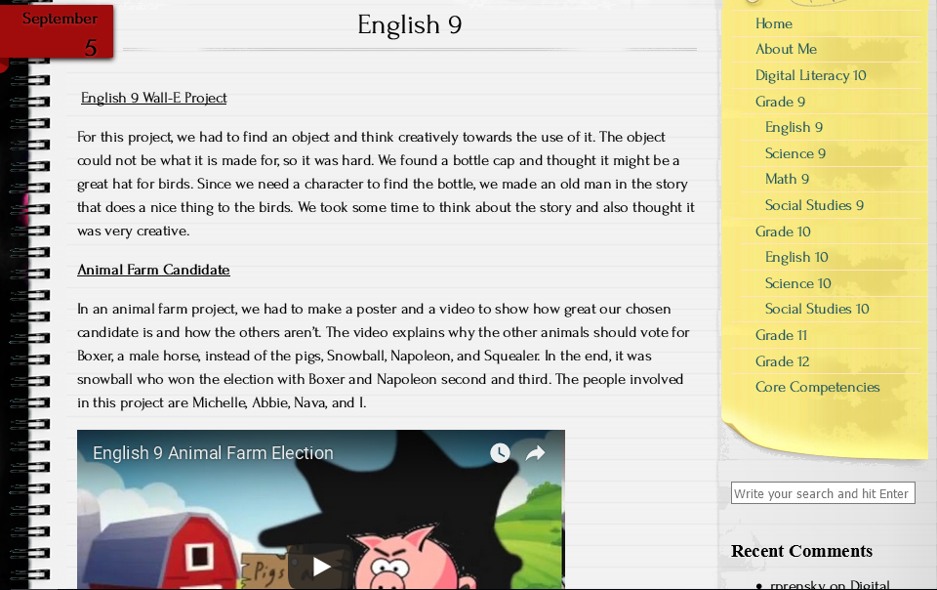
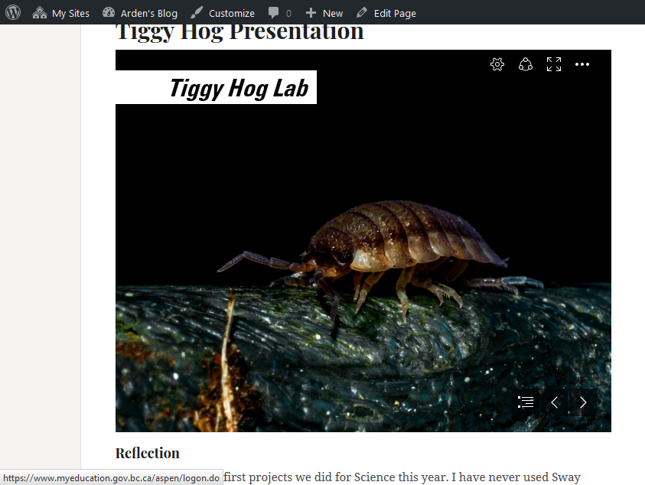
Examples of student work from 1st Semester in English and Science 9.

Slide 11
Why Bring Your Own Device
No papers to lose.
Study and work anywhere at any time.
Lighter backpack.
Access to online resources at all times
Everything on one device (Office 365 Access – Free to SD43 Students)
Ability to collaborate more easily.

Slide 12

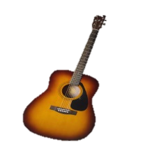


Elective Choices…
Grade 9 students have 3 choices
Languages Mandarin, Spanish, Japanese, French
Arts Dance, Art, Hollywood, Photography
Applied skills Info-Tech, Tech Ed, Foods, Textiles, Bus Ed
Music Guitar
Fitness Fitness Co-Ed, Women’s Fitness
(does not replace PHE)
Leadership Leadership

Slide 13
Alternate Courses (2 back-up Electives)
These may be used if we can’t get one of their elective choice!
Outside the Block 2 - 5 Timetable Courses
Many choices including Musical Theatre, Weight Training , Agility, Band & Choir!
AM (Before School Hours)
FL (Flex & Lunch)
PM (After School Hours)

Slide 14

Sample Timetable…
Semester 1:
Block 2 - PE 9
FLEX
Block 3 - Science 9
Block 4 - English 9
Block 5 - Photo 9
Concert band 9 linear
Semester 2:
Block 2 - Math 9
FLEX
Block 3 - Social Studies 9
Block 4 - Foods 9
Block 5 - Hollywood 9
Concert band 9 linear

Slide 15



And now a word from our music department…
Ms. Kathy Fester

Slide 16

How Do You Decide?
What you like to do!
Your skills and talents!
Where you excel!
Challenging yourself to try
something new!

Slide 17

Choose Courses Wisely
SPRING 2018
Counsellors will visit feeder middle schools to go over the Grade 9 course selection process and give out the forms:
3 elective requests – in order of preference
2 alternate requests- course options just in case
These are requests – there are many reasons a student may not get their top 3 (course conflicts, class sizes, class cancelations etc)
WE WILL ALWAYS DO OUR BEST TO HELP STUDENTS GET COURSES THAT THEY WILL ENJOY!

Slide 18



Going to High School…
What Should Your Child Expect?
Smaller “team” larger environment
  easier to fly (or swim) under radar
New routines, new clubs / activities, lockers
New friends
More freedom = More responsibility
Different teachers for different subjects

Slide 19
Ways to Support Your Teen
Attendance
  Communicate and keep us informed
Setting Goals
  Specific, measurable, attainable, realistic, time-based
Study
  Set aside time (There is always something to do)
  Encourage extra help, access FLEX time

Slide 20




Time is the best gift to give your Teen
Discuss:
How to handle peer pressure
Attendance Expectations
Facing each day positively
Homework expectations, organisation, study time at home
Praise and reinforcement
Ask questions (of your teen, teachers, counsellors, & administration)
Learn about and use the resources available
Getting involved!

Slide 21





There are many ways for them to get involved…
Clubs
Leadership Opportunities
Music
Sports Teams
Intramurals
Volunteering

Slide 22


Stay Connected…
Telephone
Teacher email
Heritage home page
Teacher websites
Counsellor websites
Newsletters
Report cards
Parent nights
Heritage App

Slide 23


How is your child going to make their mark?
Encourage them to get involved
Do what you love & love what you do

Slide 24
Important Dates:
Jan 19th
Math 9 Accelerated Applications due to Middle School Counsellors
February 13th
Counsellors @ Eagle Mountain
March 9th
Counsellors @ Summit & Scott Creek
Jan 26th
Grade 8 “Tour at the Woods” 12 - 2:30 pm
Accelerated Math 9 Assessment to follow tour ( 2:45 - 4:45 pm)

Slide 25

General Questions?
For child specific questions please email your child’s counsellor or admin!
Last Names | Counsellor | Admin
A – G | Shaunna Martin smartin@sd43.bc.ca | Jill Reid jreid@sd43.bc.ca
H – N | Paul Gangnes pgangnes@sd43.bc.ca | Manjit Rai mrai@sd43.bc.ca
O – Z | Curt Dewolff cudewolff@sd43.bc.ca | Mark Rao mrao@sd43.bc.ca
Student Services | Pat Vance pvance@sd43.bc.ca
EAL | Angeline Lee alee@sd43.bc.ca

